Slide 1

Professional Skills to a Successful Career
What I’ll be speaking about:
Professional skills are skills that graduates need to posses in order to be successful in their professional practice. These skills range from highly specific ones related to the graduate's field(s) to more general, transferable ones such as communications and ethical practices.
When graduates apply for a job, most employers want to know what professional skills they have already, and how willing they are to learn industry and worksite specific skills.

Slide 2
Speaker Profile
Felix has over 30 years of international F&B experience. His achievement roles were in areas of F&B operations, franchising development of systems and strategies, international franchise law, business development, marketing, human resource and finance.
• Chief Operating Officer of Milano Coffee JSC, Vietnam (1,500 franchised coffee shops across Vietnam)
• Director of Franchise Business for The Coffee Bean & Tea Leaf (30 countries across SEA, East Asia & Middle East)
• Head of Franchise Development for PastaMania Singapore (10 countries across SEA, East Asia & Middle East)
• Felix holds a B.Sc. Business Studies & Economics from University of Western Australia and an Advanced Certification in International Franchise Law from University of New South Wales, Australia

Slide 3

Career Development
Its about you identifying your potentials and developing them no matter the circumstances
Its best to do want you love doing best so that you can work hours in your lifetime than feel miserable doing something you don't like for about twenty years
Believe in yourself and don't let any thing discourage you

Slide 4

Career & Career Development
What is Career?
Def. (Oxford English Dictionary) A person’s course or progress through life. It also pertains to his occupational or profession that usually involves special training or formal education and is considered to be a person’s lifework
What is Career Development?
Career development is an ongoing process of gaining knowledge and improving skills that will help an individual to establish a career plan

Slide 5

Why Career Development?
Today’s Generation Students ... …
Never plan for the future
Follow the crowd
Choose by influence of others
Accept the parent’s verdict(decision) by force
Get tempted by current trends
Jump into any career
Lack motivation
Fail to ‘’discover their lives’’
Live in a fantasy world

Slide 6

Current Trends
Focus is lost
Effort to increase quantity
Survival of the fittest
Less influence by parents, teachers, etc
Increasing Dropouts
Checking quality in products such as food and clothing but not education
Increasing competition
Effort to increase quantity
A-I-M LESS process

Slide 7

Who are Responsible?
Students themselves
Parents - most of them
Teachers - not every body
Schools & Colleges – majority of them
Society
Government
People who have knowledge
People who achieved success but forgot others
People who can influence others for good

Slide 8

WHAT THEN DO
WE DO ???

Slide 9

So … WHAT DO YOU WANT TO
DO FOR THE REST OF YOUR LIFE?

Slide 10

Why Select a Career?
We have been created unique (Eg: Fingerprint)
We are born only once
We spend almost 40 years on our work
A total over 80,000 hours , we work
Now ask yourself how you will spend these 80,000 hours before you die?

Slide 11
The Career Decision-Making Process
Discovering Yourself
Evaluating the Decision
Exploring Options
Taking Action
Making a Decision

Slide 12

Discovering Yourself
What are my interests? Values? Skills?
Personality preferences?
Strengths?
What are three careers that interest me?
What are three college majors that I want to explore?

Slide 13

Exploring Options
What information or individuals can help me to explore my college or career options?
What classes or activities can help me to develop my strengths?
How can I learn more about informational interviews, job shadowing, exploratory internships, service learning, civic honors, or student organizations to gain first-hand experience?

Slide 14

Making Decisions
How much time and energy am I willing to invest to make a career decision?
Who is part of my support system to help me evaluate the pros and cons?
What are my top priorities to consider for this decision?

Slide 15

Taking Action
How can I strengthen my readiness for success in a college major?
What is one goal that I have?
How can I reach it?
What action can I take now?
Which one of my talents can I develop through classes or outside activities?

Slide 16

Evaluating the Decision
Is my decision a realistic option?
Is there anything preventing me from achieving this goal?
What would it mean if I didn’t have any barriers?
Who in my support system can assist me with achieving this goal?

Slide 17
Career Cycle 1
Self Belief
Steps to Progress
Plan
Facts
5 Most Crucial Factors
A path that makes some obtain his/her wishes: course, job and location
Commitment
Persevere

Slide 18

How Do We Decide?
Abilities, Aptitude & Interest
+
Personality & Motivation
= CAREER CHOICE

Slide 19
Career Cycle 2
Education
Career Planets
Self
Family
A path that leads to Advancement& Promotion in Life
Career Life System
A path that leads to Advancement& Promotion in Life
Vision
Society

Slide 20

Course Selection
Better Family Life
Helping the Nation
Develop Skills, Motivation, Plan Intelligently
Improve Reading
Taking Notes You can use

Slide 21

Reading Skills
Learn Terms
Get the Structure
Skim the Chapter
Thorough Reading
Review
Decrease in reading due to:
  Reading aloud/moving lips
  Using Finger/head to follow
  Insufficient vocabulary

Slide 22
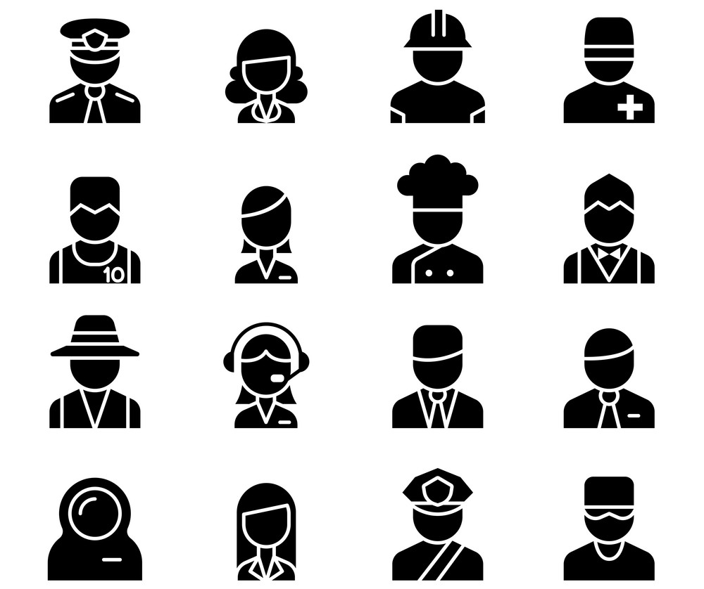
Enlist Interested Career/Profession
Make Check-list
Crack all Entrance Exam
Get Advice
Proper Planning Prevents Poor Performance
No short-cut to success (Hard work)

Slide 23


Slide 24
TRAVEL & TOURISM
Introduction
The jobs in the travel sector are diverse in nature. Travel is a very competitive field since all travel agents are capable of providing almost the same kind of facilities and services. Hence travel agents work in an atmosphere of keen competition for referrals
Personality•
The prime requirement for success in the field of travel and tourism is a genuine interest in travel. Personal knowledge and experience of travel to major tourist destinations, hotels, places of interest, local customs, would make a travel agent an authentic and well versed source of guidance to the prospective tourist

Slide 25
Hotel Industry
Introduction
Hotel Industry has a great variety in terms of size, clientele it aims to serve, and its location. However, for the efficient functioning of any hotel – large or small, work is divided among key departments – Management, catering, front office, housekeeping, accounting, marketing, engineering, forecasting
Working Conditions
Employees in most of the hotel operational areas enjoy pleasant, clean and comfortable working conditions
Personality
This dynamic and variegated sector offers a whole range of jobs for young men and women with an outgoing and pleasant personality, a flair for creativity and capacity for hard work

Slide 26

Courses & Work Area
Travel Agencies & Plan
Accommodation + sites of visit, …
Diploma/Degree in Tourism/Catering/Sociology
Diploma/Degree in Hotel Management
Diploma/Degree in Tourism
Diploma/Degree in Food Preservation

Slide 27


